Slide 1
Real Time Reconstruction of Compressed Sampling Medical Imaging
Dr. Rafiqul Islam
Associate Professor

Slide 2
Presentation Outline
Introduction
Compressed Sensing
Non-linear Reconstruction
Proposed Methodology
Experimental Results
Conclusion

Slide 3
Introduction
Magnetic Resonance Imaging (MRI) is a fascinating imaging technology for capturing image to visualize inside of the human body.
Painless and non-invasive procedure.
MRI does not use any ionizing radiation.

Slide 4
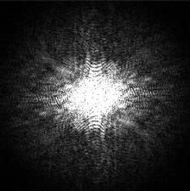
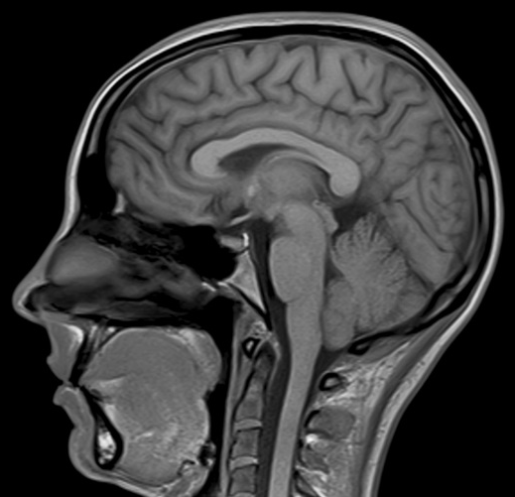

Introduction
MRI Principle
k space
image
Data
acquisition
IDFT

Slide 5
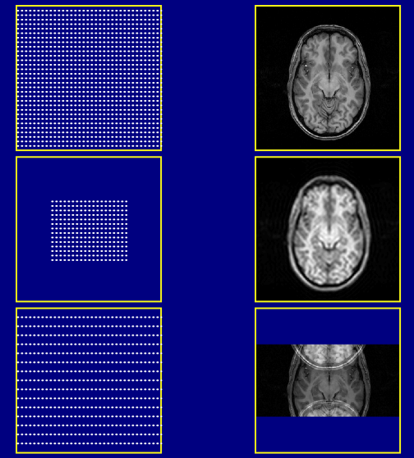
k-space
Image
Full-FOV,
high-res
Full sampling
2DFT
Full-FOV,
low-res:
blurred
Reduce kmax
Low-FOV,
high-res:
may be aliased
Increase Δk

Slide 6
Introduction
Inherent slow data collection
Limits spatial resolution
Limits temporal resolution
Introduces artifacts in image
Moreover, slow acquisition is uncomfortable for patients, especially-
Who are anxious
Who can not keep still or motionless
Who have limited breath-hold capacity, and
Who are uncooperative such as children

Slide 7
Introduction
Acquisition of k-space data within reasonable time is a challenge
Possible solution
Enables faster acquisition by reducing sampling data
These challenges can be solved using compressed sampling

Slide 8
Compressed Sampling
Compressed Sampling in MRI, while reducing acquisition time, enables high subsampling factors maintaining diagnosable image quality.
This technique changes the goal based on three golden rules:
Incoherent sub-sampling
Transform sparsity
Non-linear iterative reconstruction technique

Slide 9
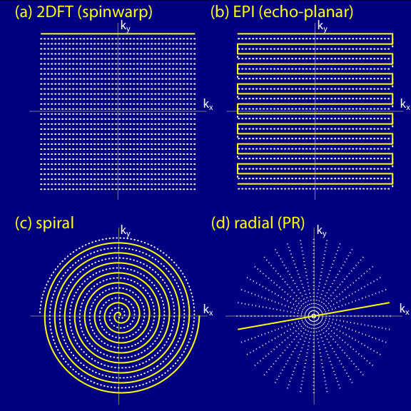
Many possible trajectories through k-space…

Slide 10
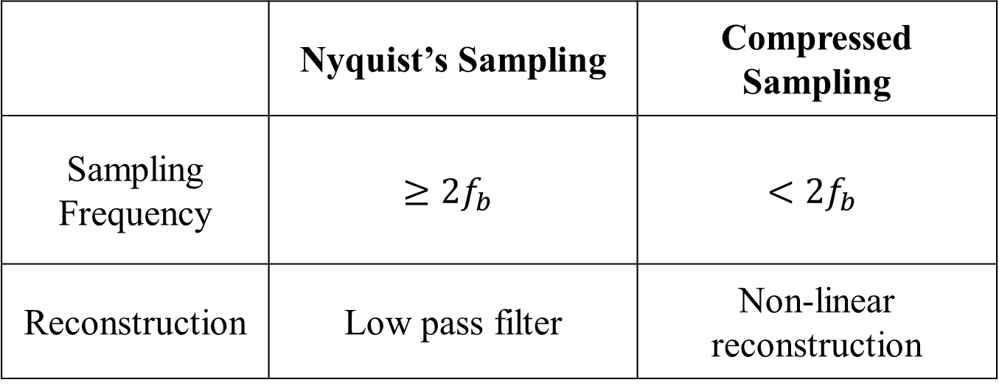
Compressed Sampling
 | Nyquist’s Sampling | Compressed Sampling
Sampling Frequency | $$≥{2f}_{b}$$ | $$<{2f}_{b}$$
Reconstruction | Low pass filter | Non-linear reconstruction

Slide 11
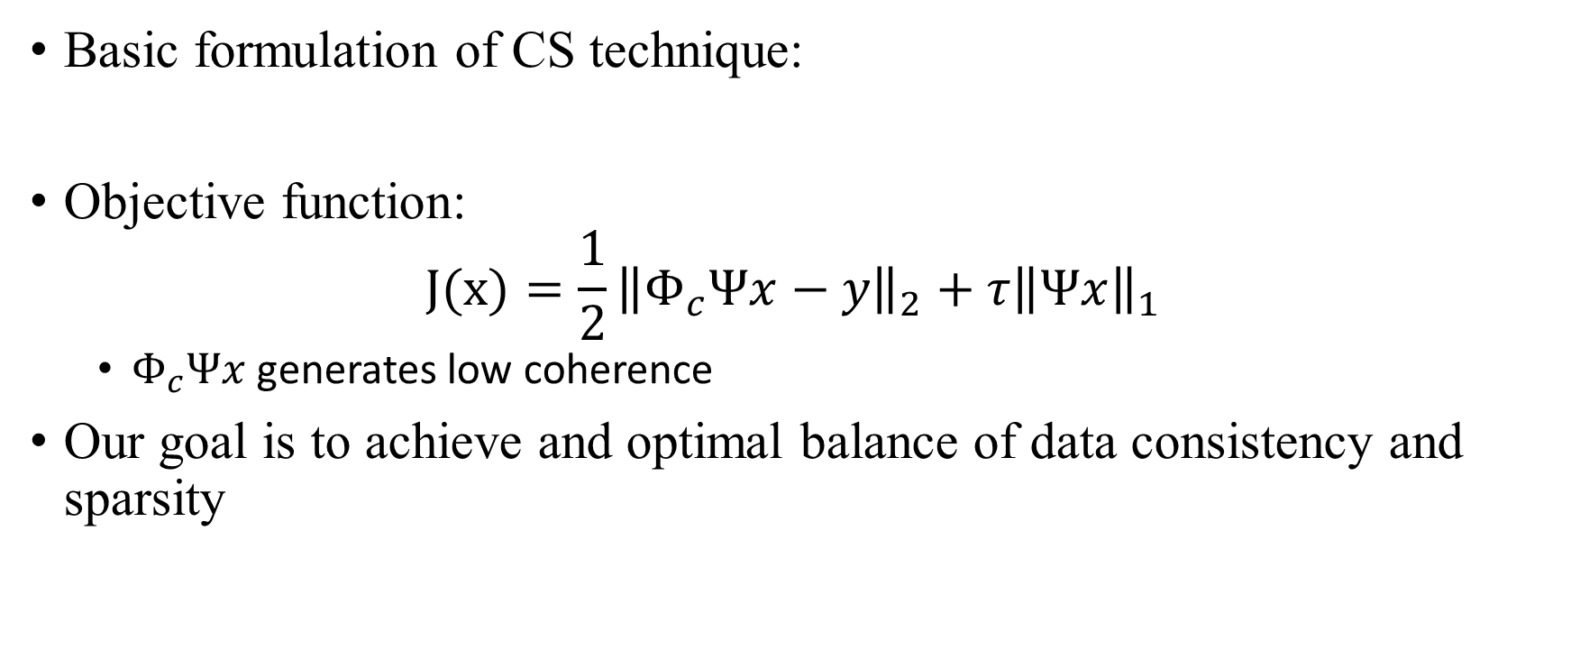
Non-linear Iterative Reconstruction
Basic formulation of CS technique:
Objective function:
$$J(x)={\frac{1}{2}\left\|Φ_{c}Ψx−y\right\|}_{2}+{τ\left\|Ψx\right\|}_{1}$$
$Φ_{c}Ψx$ generates low coherence
Our goal is to achieve and optimal balance of data consistency and sparsity

Slide 12
Non-linear Iterative Reconstruction
Total Variation (TV) based iterative algorithm
Soft-thresholding based iterative algorithm
Fast Composite Splitting Algorithm
Many More….
References
Beck A, Teboulle M. 2009.A fast iterative shrinkage-thresholding algorithm for linear inverse problems.
Guerquin-Kern M, Haberlin M, Pruessmann KP, Unser M. 2011. A fast wavelet-based reconstruction method for magnetic resonance imaging.
Huang J, Zhang S, Metaxas D. 2011. Efficient MR image reconstruction for compressed MR imaging.
R. Islam 2014, Improved regularisation constraints for compressed sensing of multi-slice MRI

Slide 13
Proposed Methodology: Algorithm Flowchart
Initialization
(All Parameters)
Initialization
(Reconstructed Image)
Iteration:
De-noising followed by inverse wavelet transform:
Converge or max iteration
N
Y
Quit and Save reconstructed image

Slide 14
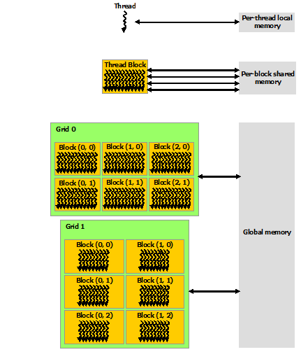
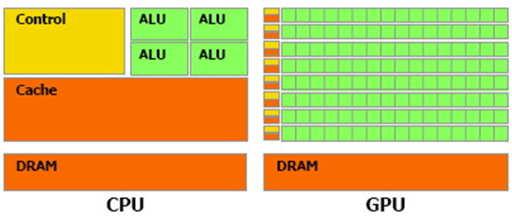
Implementation on GPU: Background
GPU is coprocessor, which is controlled by CPU.
It consists of hundreds of special purpose streaming multiprocessors (SMs)
It is virtually partitioned into several grids
Each grid is further partitioned into multiple blocks
Each block comprises hundreds of threads,
which run concurrently on SMs
CPU-GPU comparison
GPU

Slide 15
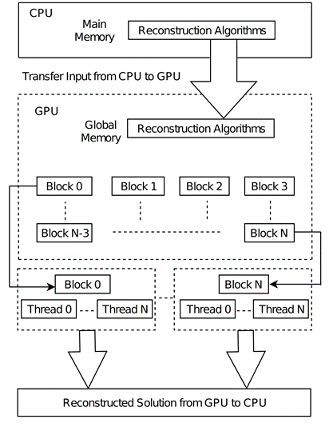
Implementation on GPU: Mapping

Slide 16
Experimental Setup: System Configuration
Property | CPU | Property | GPU
Processor | Core i7 | Brand | NVIDIA Geforce 730
Clock Speed | 3.40 GHz | Graphics Speed | 602 MHz
No. of Cores | 2 | CUDA Cores | 384
No. of Threads | 4 | Max Threads | 1024
RAM | 8 GB | Graphics | 2024 MB
Cache | 3 M | Bandwidth | 14.40 GB/s

Slide 17

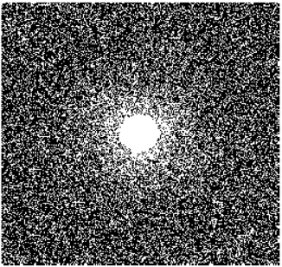
Experimental Setup : Input and sampling mask
(a) Original Image
(a) Undersampled Mask
Fig: Visual display of (a) Original Image (b) Random Undersampled Mask

Slide 18
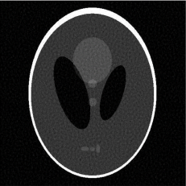
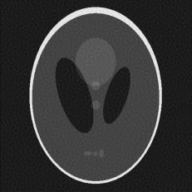
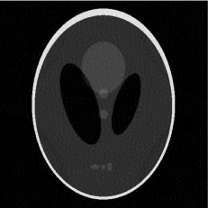
Experimental Result: Visualization
(a) TV
(b) ST
(c) Proposed method
Fig. Visual display of the output of the algorithms using (a) TV (b) ST and (c) proposed prior.

Slide 19
Experimental Result: PSNR
Image Size | Sampling measurements | Algorithm Name
 |  | TV | ST | Proposed
256×256 | 50% | 27.52 | 30.02 | 31.95
 | 66.7% | 23.34 | 24.32 | 28.40
 | 75% | 21.16 | 22.54 | 26.86
512×512 | 50% | 31.73 | 33.27 | 35.61
 | 66.7% | 25.87 | 26.72 | 29.97
 | 75% | 24.70 | 25.13 | 28.73
TABLE. PSNR Comparison of Different Algorithms

Slide 20
Experimental Result: Execution Time
Processor | Algorithm Name | Execution time (256×256) | Execution time (512×512)
CPU | TV | 294 | 2135
 | ST | 228 | 1829
 | Proposed | 274 | 2062
GPU | TV | 14 | 80
 | ST | 07 | 71
 | Proposed | 09 | 78
Speed-up | TV | 21 | 26
 | ST | 32 | 25
 | Proposed | 30 | 26
TABLE. Execution Time, in Seconds

Slide 21
Conclusion
The proposed prior-based method exhibits improved performance in terms of quality of the reconstructed image
The proposed GPU implementation exceedingly outperforms the CPU implementation, yielding a speedup of 26x, 32x, and 30x over the CPU-based methods, for TV, ST and proposed implementation respectively
The proposed GPU implementation exhibits massive parallelism that can enable real-time reconstruction of CS MRI

Slide 22
Thank you
Any Questions?

